Slide 2
Clocks, Counters, and Timers
HCM - 2021

Slide 3
Agenda
Clock sources
Basics of counters and timers
Clocks, counters, and timers in ARM Cortex-M chips

Slide 4
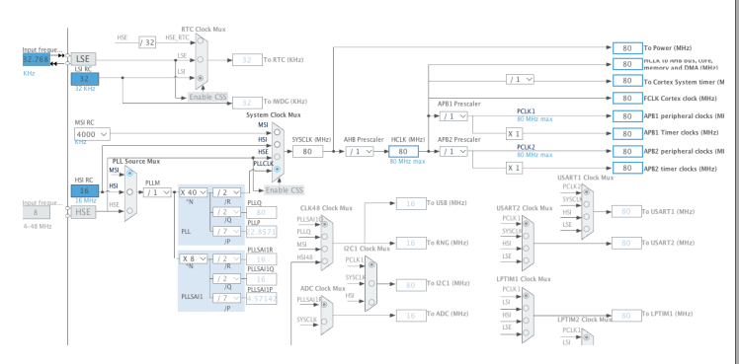
Clock Signals
Clock signals are required for a lot of stuff
CPU execution
Internal communications, e.g., peripheral bus
External communications, e.g., USB, USART
Analog-to-digital conversion
Tick generation for timers

Slide 5
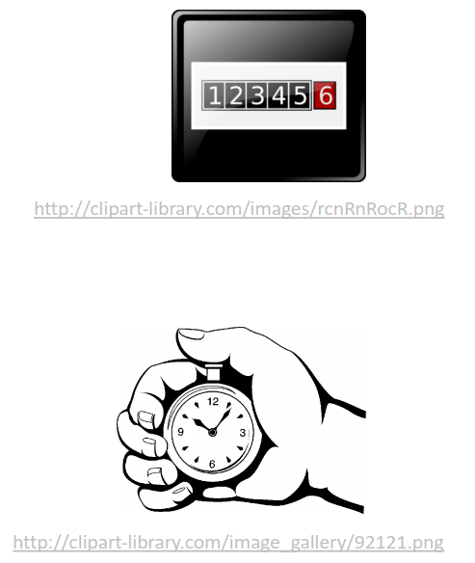
Counters and Timers
Counters and timers are ones of the
most important components of MCUs
A counter keeps track of how many
event ticks have occurred
A timer is a counter that counts
deterministic clock cycles
Two terms are often used
interchangeably

Slide 6
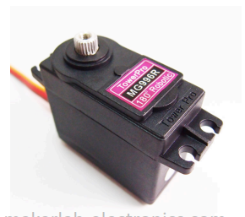
Typical Uses of Counters/Timers
Scheduling future events
One-shot events
Periodic events
Input capture
Measuring input pulse length
Output waveform generation
Output compare – flags or toggles output pin when the counter reaches a certain value
Pulse-width modulation (PWM) – generates
analog output encoded as pulse length

Slide 7
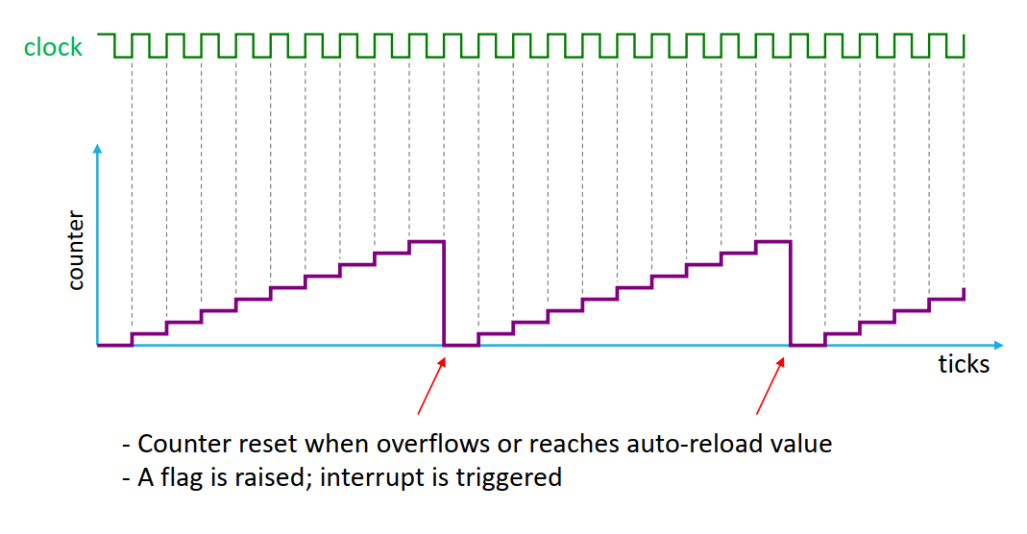
Basic Counter/Timer Operations

Slide 8
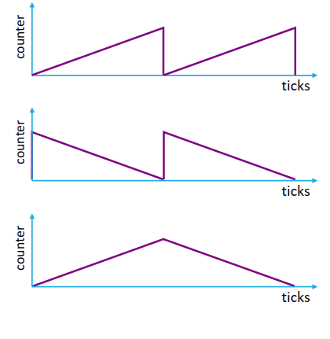
Counter Modes
Up-counting
Down-counting
Center aligned (up/down)

Slide 9
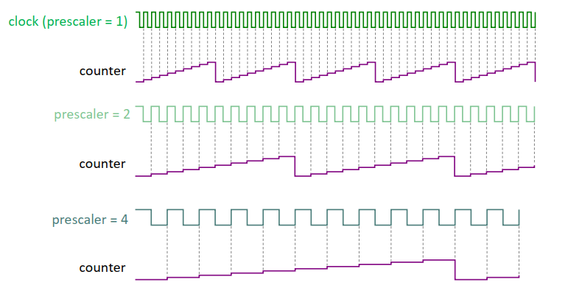
Prescaler
Divides clock frequency; increases timer period

Slide 10
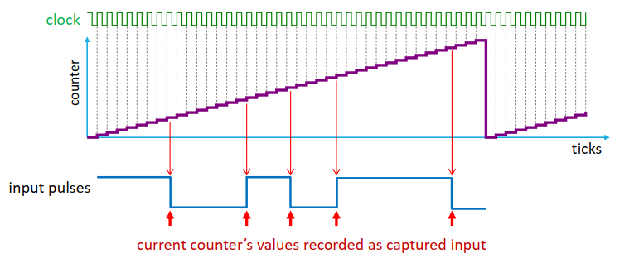
Input Capture
Measures input pulse lengths
Applications: decoding remote control signals, distance measurement

Slide 11
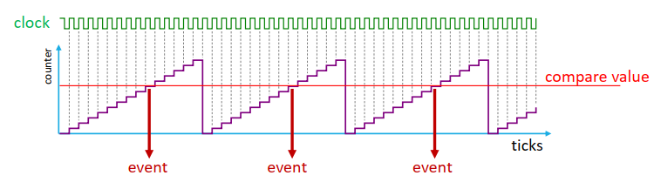
Output Compare
Generates an event when counter matches a certain value
Possible MCU’s behavior when receiving a compare event:
Sets a flag
Generates an interrupt
Sets, resets, or toggles output pin

Slide 12
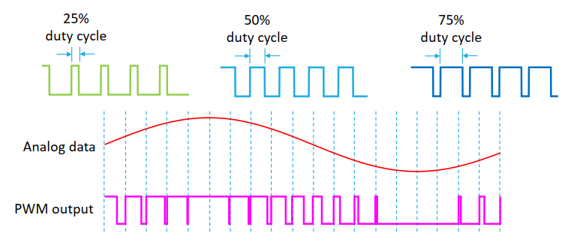
Pulse-Width Modulation (PWM)
PWM utilizes duty cycle control to simulate analog output
Applications: motor speed control, servo position control, LED brightness control

Slide 13
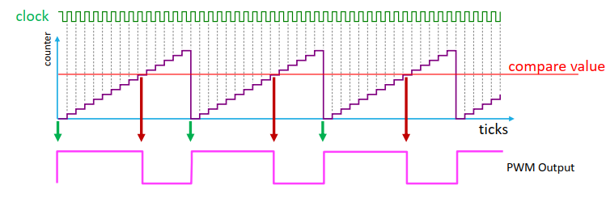
PWM Waveform Generation
Typical MCU behavior
Auto-reload event sets output pin high
Output-compare event sets output pin low
Output compare value determines PWM duty

Slide 14
STM32L4xx’s Timers
Basic timers: TIM6/TIM7
General-purpose timers: TIM2/TIM3 and TIM15/TIM16
Advanced timers: TIM1
Low-power timers: LPTIM

Slide 15
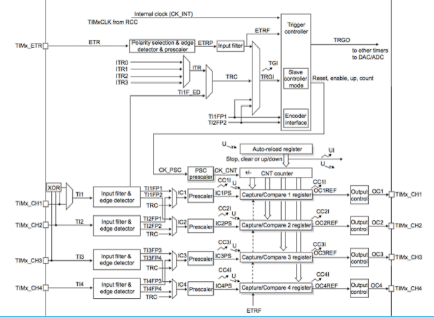
STM32L4xx’s General-Purpose Timers

Slide 16
Important Timer-Related Registers
TIMx->PSC (16 bits)
Prescaler for TIMx
PSC = 0 → no prescaler (prescaler = 1)
PSC = n → prescaler = n+1
TIMx->ARR (32 bits)
Auto-reload register for TIMx
Counter counts up to and including ARR
Therefore, reload occurs every ARR+1 clock ticks
TIMx->CCRy (32 bits)
Capture/compare register for TIMx, channel y

Slide 17


Calculating Timer Period/Frequency
Let
PSC = Prescaler (TIMx->PSC)
ARR = Auto-Reload Register (TIMx->ARR)
Then
or

Slide 18
Example: Timer Period
What is the timer’s period in milliseconds with the following configuration?
Up-counting configuration
Input clock: 80 MHz
Prescaler (PSC): 999
Auto-reload register (ARR): 4999

Slide 19
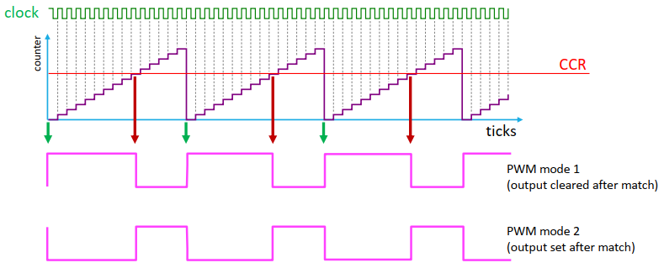
PWM Modes 1 vs 2

Slide 20
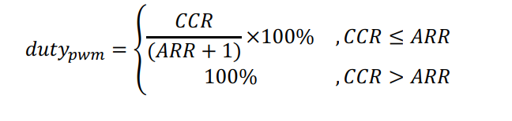
Calculating PWM Duty Cycle
Assume up-counting configuration and PWM mode 1
(output is clear when compare match)
Let
ARR = Auto-Reload Register (TIMx->ARR)
CCR = Capture/Compare Register (TIMx->CCRy)

Slide 21
Example: PWM Duty Cycle
What is the PWM’s frequency and duty cycle with the following configuration?
Up-counting configuration
Input clock: 80 MHz
Prescaler (PSC): 79
Auto-reload register (ARR): 4999
Capture/compare register (CRR): 2000
PWM mode 1

